Slide 1
EXPLORING THE POWER OF JAVA
With B.Abraham Rahul Lazaras

Slide 2
Areas To Explore
01
02
05
03
04
History of Java
Methods
static Keyword
StringBuffer & StringBuilder
‘this’ Keyword

Slide 3
History Time!
In this part of the section we will see about the birth of java and why it is created in first place…

Slide 4
Java Time Line
1996
1998
2002
2006
2014
2018
2020
2022
2024…
1991
1997
2000
2004
2011
2017
2019
2021
2023
It all began in 1995 when James Gosling and his team at Sun Microsystems introduced Java
The subsequent release of Java 1.0 in 1996 marked its initial foray into the computing world. Over the years, Java has undergone numerous updates and enhancements, introducing features like Swing for GUI development
The release of Java 5 in 2004 was a milestone with the introduction of generics, metadata annotations, and the enhanced for loop. Subsequent versions continued to refine the language, introducing features such as lambdas, the module system in Java 9, and local-variable type inference in Java 10.

Slide 5
JAMES GOSLING
Java was originally designed for interactive television, but it was too advanced technology for the digital cable television industry at the time. The history of Java starts with the Green Team.
However, it was best suited for internet programming.
The principles for creating Java programming were
Simple & Robust,
Portable & Secure,
Platform-independent & Architecture Neutral,
Object-Oriented, Interpreted, and Dynamic,
High Performance & Multithreaded.

Slide 6
Recent Uses of JAVA
Development Of Scientific Application
Enterprise Applications Development
Development Of Web Applications
Mobile Applications
Game Development
Desktop GUI Application

Slide 7
Methods

Slide 8
Method?!!
The method in Java is a collection of instructions that performs a specific task.
.
It provides the reusability of code.
We can also easily modify code using methods.
The method is executed only when we call or invoke it.

Slide 9
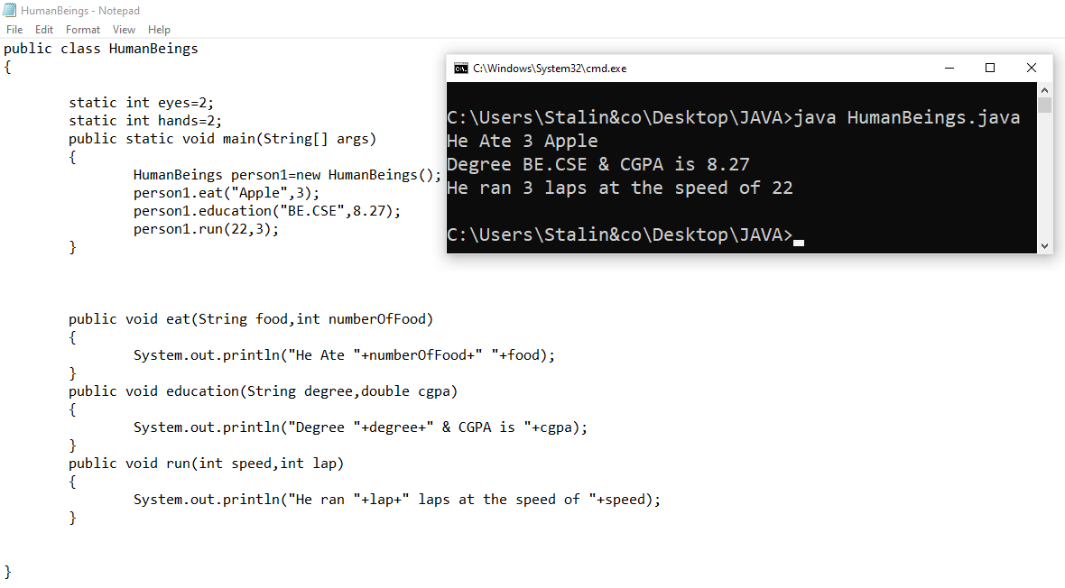
Real time Example:

Slide 10
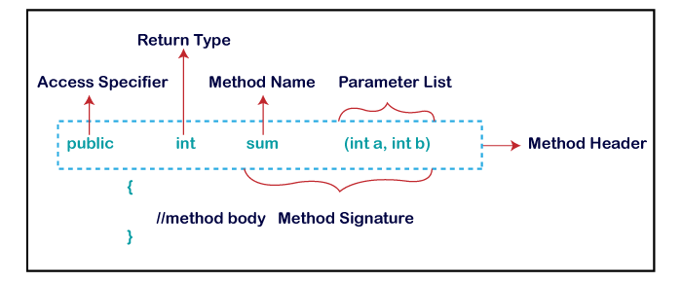
Method Declaration

Slide 11
Method Declaration
Lets see an Example Method to understand Method Dec
public int methodName(int a,int b)
{
//body
}
public is Access Modifier
int is Return Type
methodName is The name of the Method
(int a,int b) is parameter
Both Method name and Parameter is called Method Signature

Slide 12
Types Of Methods
Methods in JAVA have 2 Types:
User-Defined
The method written by the user or programmer is known as a user-defined method. These methods are modified according to the requirement.
Pre-Defined
Predefined methods are the method that is already defined in the Java class libraries is known as predefined methods. It is also known as the standard library method or built-in method. We can directly use these methods just by calling them in the program at any point. When we call any of the predefined methods in our program, a series of codes related to the corresponding method runs in the background that is already stored in the library.

Slide 13
Various Methods
Instance Method
Final Method
Static Method
Accessor Method & Mutator Method
Abstract Method
Factory Method

Slide 14
Accessor & Mutator
Accessor methods is also known as getter methods.
These methods allow you to retrieve the value of an object's private instance variables.
These methods provide read-only access to the object's state.
By using accessor methods, you can ensure that the object's state is not modified by external code.
Mutator Methods is also known as setter methods.
These methods that allow you to modify the value of an object's private instance variables.
These methods provide write-only access to the object's state.
By using mutator methods, you can ensure that the object's state is modified only through a controlled interface.

Slide 15
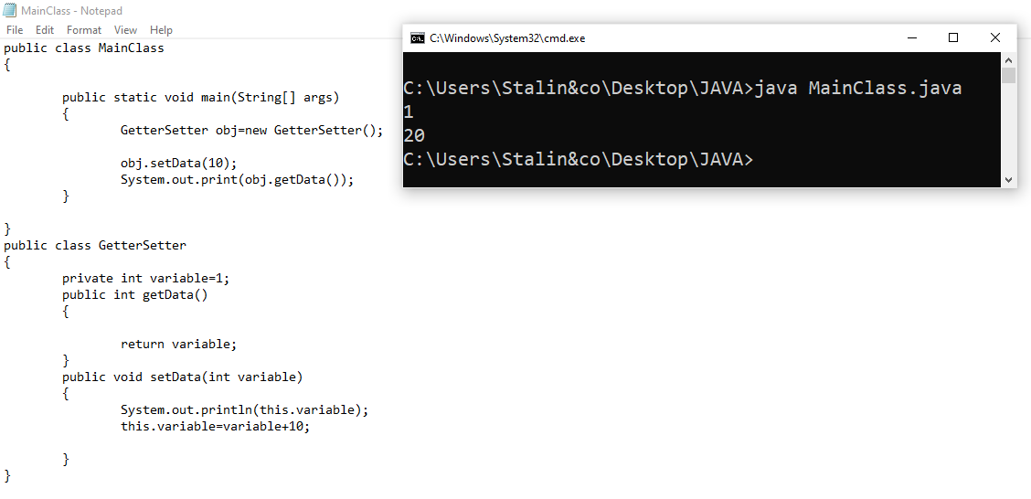
Example

Slide 16
Abstract Method
Abstraction is defined as hiding the unnecessary details from the user.
It increases the efficiency and thus reduces complexity.
In Java, abstraction can be achieved using abstract class and methods
A method declared using the abstract keyword within an abstract class and does not have a definition (implementation) is called an abstract method.
When we need just the method declaration in a super class, it can be achieved by declaring the methods as abstracts.
Abstract method is also called subclass responsibility

Slide 17
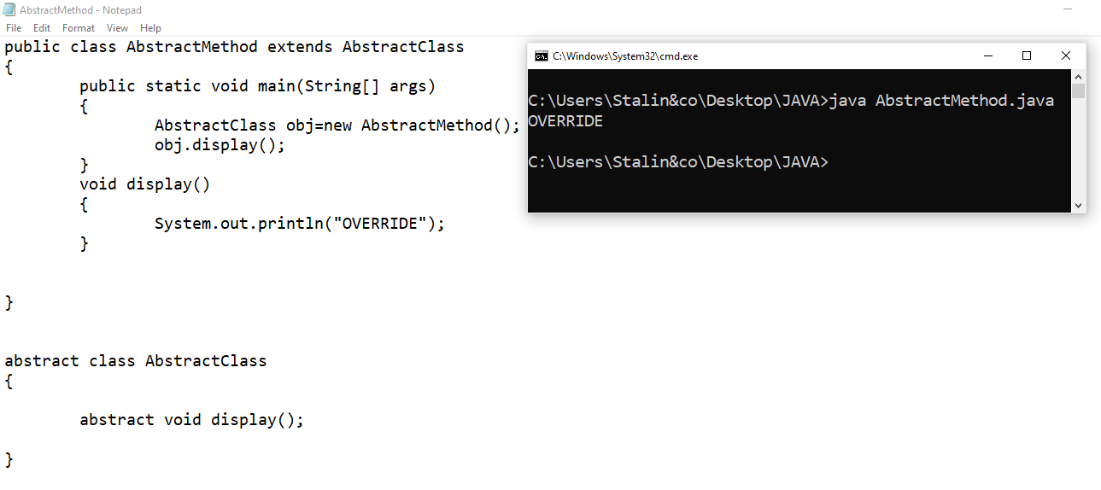
Abstract Method

Slide 18
StringBuffer & StringBuilder

Slide 19
String Buffer
Java String Buffer class is used to create mutable (modifiable) String objects. The String Buffer class in Java is the same as String class except it is mutable.
Methods
append()
insert()
replace()
delete()
reverse()
capacity() & ensureCapacity()
length()
charAt() & substring()

Slide 20
Methods In StringBuffer
append() – used to add the string or character in the last of the main string.
Ex: StringBuffer sb =new StringBuffer("Hello"); output: Helloworld
sb.append("world");
insert() – used to insert the string or character in the specified index of the main string.
Ex: StringBuffer sb =new StringBuffer("HelloWorld“); output: Hello World
sb.insert(5," ");
System.out.println(sb);
delete() – used to delete the char or string in the main string by their index.
Ex: StringBuffer sb =new StringBuffer("Hello"); output: Hlo
sb.delete(1,3);
System.out.println(sb);

Slide 21
String Builder
Java String Builder class is used to create mutable (modifiable) String. The Java String Builder class is same as String Buffer class except that it is non-synchronized.
Methods
append()
insert()
replace()
delete()
reverse()
capacity() & ensureCapacity()
length()
charAt() & substring()

Slide 22
Methods In StringBuilder
reverse() –used to reverse the main string.
Ex: StringBuilder sb =new StringBuilder("Hello"); output: olleH
System.out.println(sb.reverse());
trimToSize() – It attempts to reduce storage used to store the main string.
Ex: StringBuilder sb =new StringBuilder("Hello"); output: 5
sb.trimToSize();
System.out.println(sb.capacity());
substring() – Returns a new string from the specified index in the main string.
Ex: StringBuilder sb =new StringBuilder("Hello"); output: ello
System.out.println(sb.substring(1));

Slide 23
Difference B/w String Buffer & Builder
String Buffer | String Builder
String Buffer is less time efficient than String Builder. | String Builder is more time efficient than String Buffer.
String Buffer was introduced in Java 1.0 | String Builder was introduced in Java 1.5
Synchronized Thread Safe | Not Synchronized Not Thread Safe

Slide 24
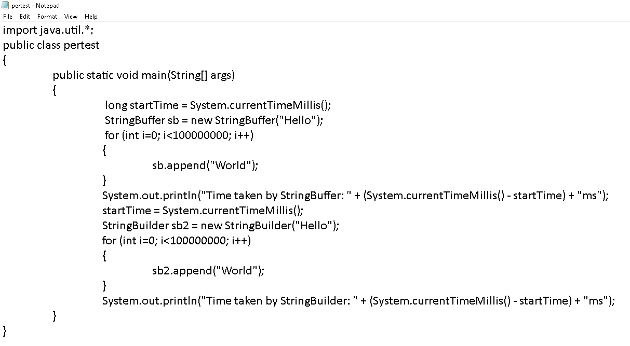
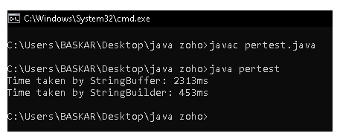
Performance Test
Java String Builder class is used to create mutable (modifiable) String. The Java String Builder class is same as String Buffer class except that it is non-synchronized.

Slide 25
‘this’ Keyword

Slide 26
Usage of ‘this’ Keyword
‘this’ is a reference variable that refers to the current object.
It is often used to disambiguate instance variables from local variables when they have the same name.
Here are some common uses of the this keyword in Java:
To refer current class instance variable.
‘this’ can be used to invoke current class method (implicitly)
‘this()’ can be used to invoke current class constructor.
‘this’ can be passed as an argument in the method call.
‘this’ can be passed as argument in the constructor call.
‘this’ can be used to return the current class instance from the method.

Slide 27
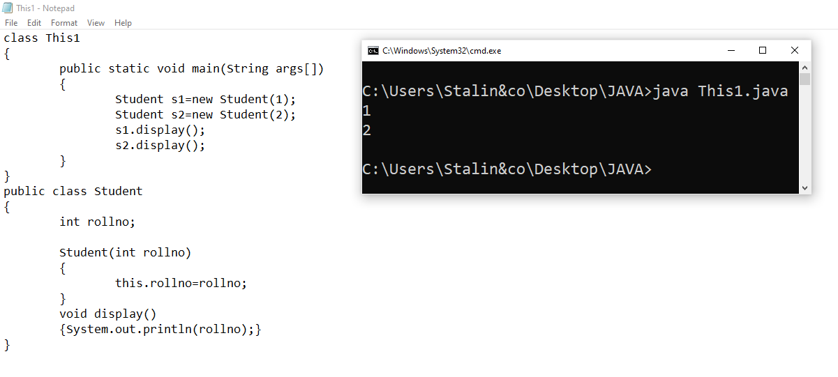
this refers to the current class instance.

Slide 28
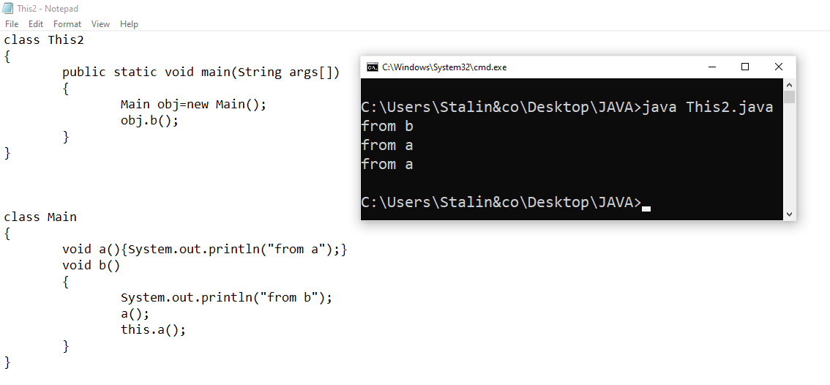
this calls the method in the class

Slide 29
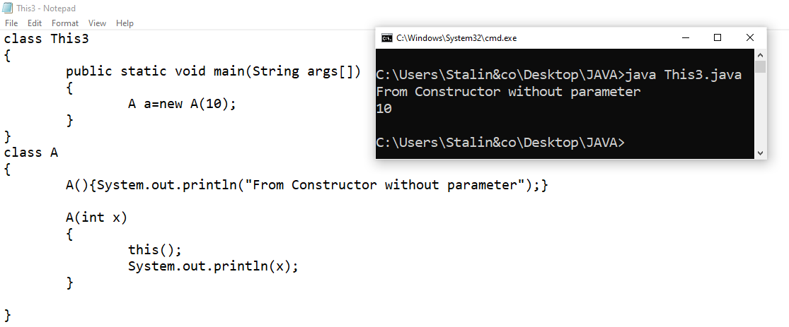
this() calls the default class constructor

Slide 30
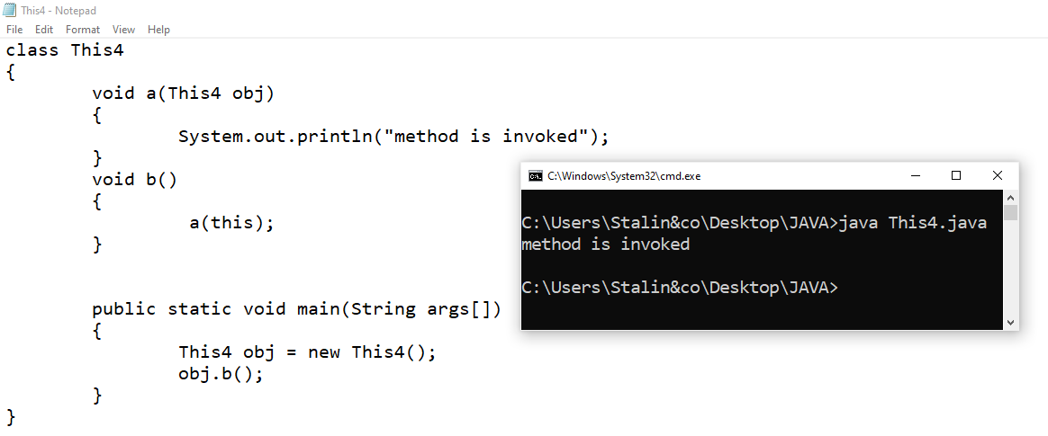
this is passed as a argument.

Slide 31
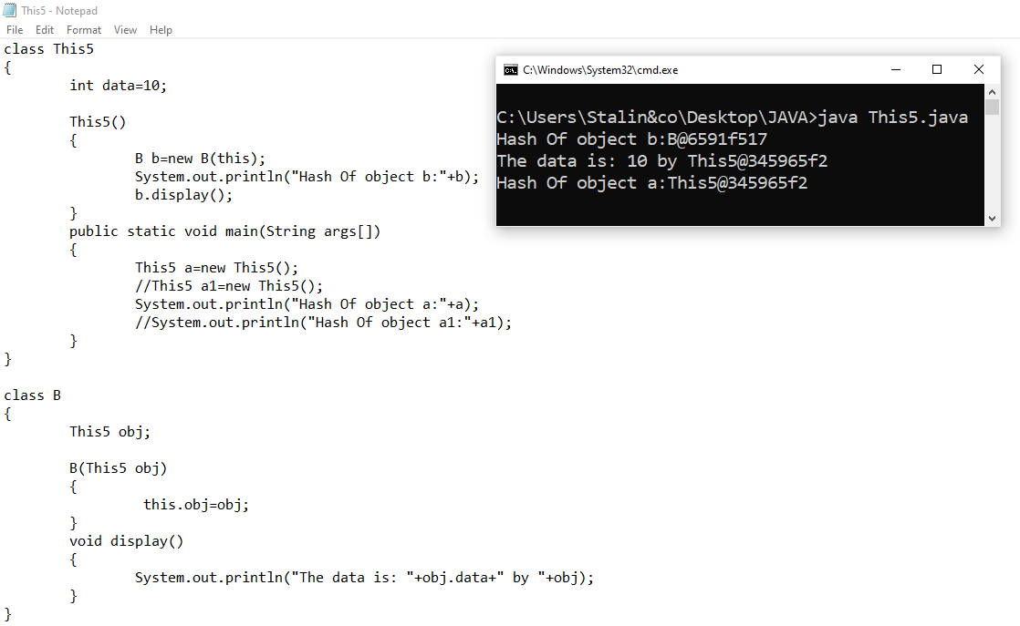
this is passed as a argument in constructor.

Slide 32
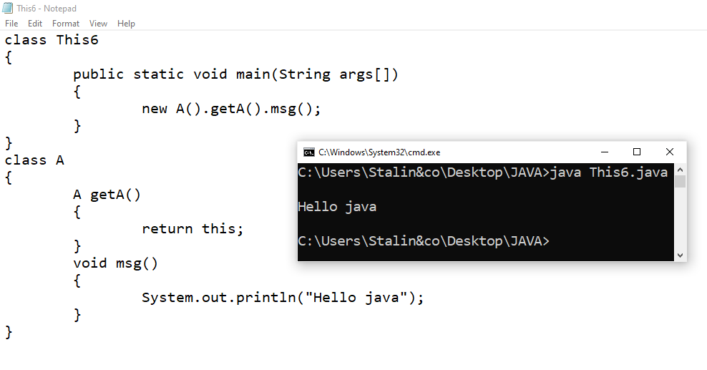
this is returned from a method.

Slide 33
static Keyword

Slide 34
Usage of static Keyword
The static keyword in Java is used for memory management mainly.
We can apply static keyword with variables, methods, blocks and nested class.
The static keyword belongs to the class than an instance of the class.
There is a specific order of priority or execution during the class loading process. This order is as follows:

Slide 35
Order of Execution
Static variables (class variables)
Static blocks : Static initialization blocks are executed in the order they appear in the class.
Static methods
Instance variables (non-static variables): Instance variables are initialized after static initialization and are associated with instances of the class.
Instance blocks : Instance initialization blocks are executed in the order they appear in the class, following the initialization of instance variables.
Constructors

Slide 36
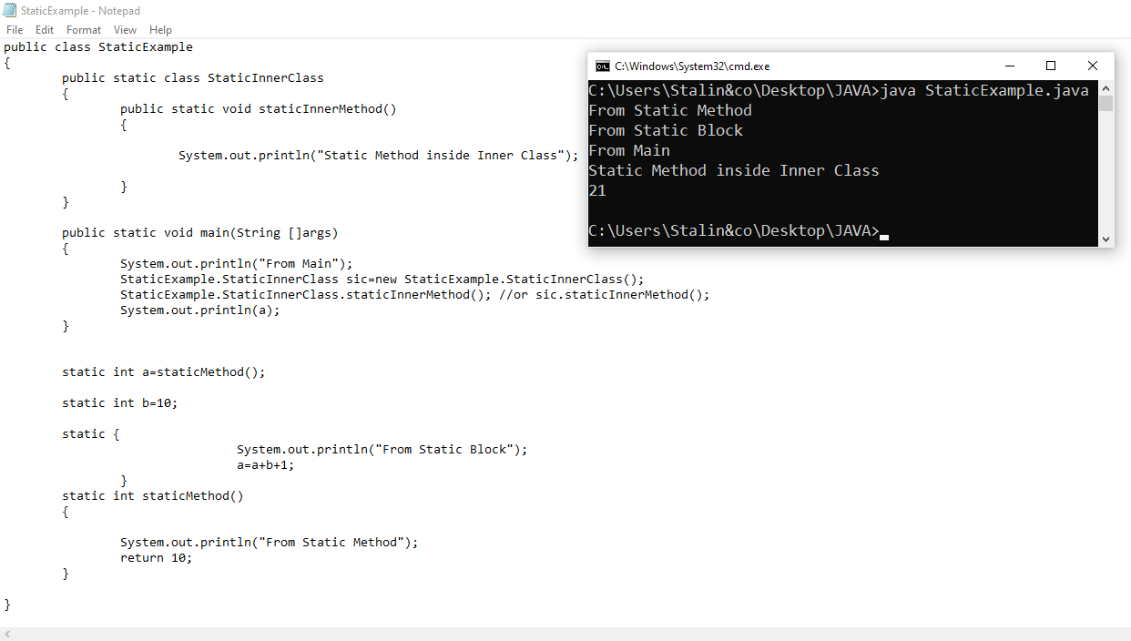

Slide 37
Anyone can write code that a computer can understand. Good programmers write code that humans can understand.

